Slide 1
SUICIDE PREDICTION USING REGRESSION
CLASSIFICATION AND NEURAL NETWORKS MODELS
Submitted by
Avhishek Biswas, Roll – 18700316065, Year – 2019, Dept. - ECE
Deep Bhattacharya, Roll – 18700316058, Year – 2019, Dept. - ECE
Ananya Talukdar, Roll – 18700316081, Year – 2019, Dept. - ECE
Arijit Chowdhury, Roll – 18700316070, Year – 2019, Dept. - ECE

Slide 2
AIM AND OBJECTIVE
In this project we are creating prediction and classification models using different machine learning methods.
Linear and Spline Regression
Neural Networks
Naïve Bayes
The data set that is being used is from Kaggle that has been produced by the Govt. Of India.
The prediction models will be predicting if a given person in a certain socio-economic category will commit suicide.

Slide 3
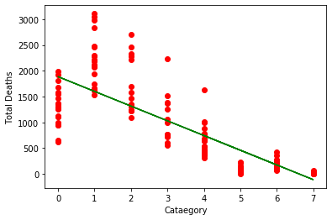
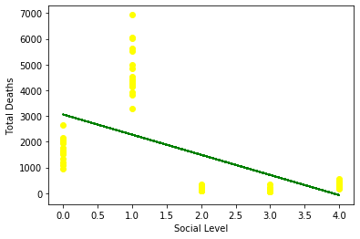
LINEAR REGRESSION
If the goal is prediction, or forecasting, or error reduction, linear regression can be used to fit a predictive model to an observed data set of values of the response and explanatory variables. After developing such a model, if additional values of the explanatory variables are collected without an accompanying response value, the fitted model can be used to make a prediction of the response.
How are we using linear regression .We are creating plots for
Educational Level vs Total Deaths and Social Level vs Total Deaths

Slide 4
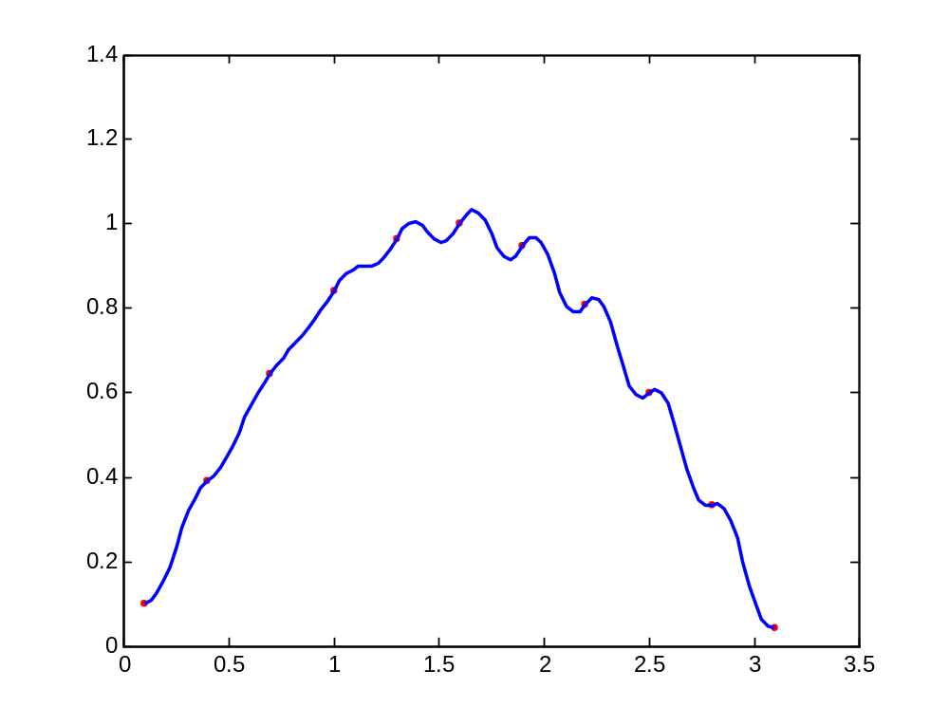
SPLINES
An interval [a..b] is subdivided into sufficiently small intervals [ξ_{j}.. ξ_{j+1}], with a=ξ₁<…<ξ_{l+1}=b,
On each such interval, a polynomial p_{j} of relatively low degree can provide a good approximation to g.
This can even be done in such a way that the polynomial pieces blend smoothly, i.e. so that the resulting composite function s(x) that equals p_{j}(x) for x∈[ξ_{j} ξ_{j+1}] , all j , has several continuous derivatives.
Any such smooth piecewise polynomial function is called a spline.
Continuous 1st derivative

Slide 5
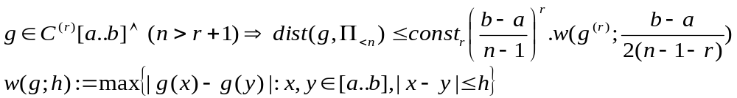
What problem splines solve?
In the simplest situation, one is given points (t_{i}, y_{i}) and is looking for a piecewise polynomial function f that satisfies f(t_{i})=y_{i} , all i, more or less.
  Exact fit → Interpolation
  Approximate fit → least squares approximation or smoothing splines
Or we have a complex function g that we want to approximate with a piecewise polynomial function f that satisfies f(t_{i})=g(t_{i}) , all i, more or less.
Why piecewise polynomials?
Jackson’s Theorem: If g has r continuous derivatives on [a..b] and n> r+1, then
The only way to make the error small is to make (b-a)/ (n-1) small → partitioning [a..b] → using piecewise polynomial approximation.
It is usually much more efficient to make (b-a) small than to increase n. This is the justification for piecewise polynomial approximation.

Slide 6
NAIVE BAYES
What is Naïve Bayes?
Naive Bayes is a simple technique for constructing classifiers: models that assign class labels to problem instances, represented as vectors of feature values, where the class labels are drawn from some finite set.
There is not a single algorithm for training such classifiers, but a family of algorithms based on a common principle: all naive Bayes classifiers assume that the value of a particular feature is independent of the value of any other feature, given the class variable.
For example, a fruit may be considered to be an apple if it is red, round, and about 10 cm in diameter. A naive Bayes classifier considers each of these features to contribute independently to the probability that this fruit is an apple, regardless of any possible correlations between the color, roundness, and diameter features.
What is naive Bayes used for?
Naive Bayes uses a similar method to predict the probability of different class based on various attributes. This algorithm is mostly used in text classification and with problems having multiple classes.

Slide 7
What is Naïve Bayes classifier?
In machine learning, naïve Bayes classifiers are a family of simple "probabilistic classifiers" based on applying Bayes' theorem with strong (naïve) independence assumptions between the features.
They are among Naïve Bayes classifiers are highly scalable, requiring a number of parameters linear in the number of variables (features/predictors) in a learning problem.
In the statistics and computer science literature, naive Bayes models are known under a variety of names, including simple Bayes and independence Bayes.
All these names reference the use of Bayes' theorem in the classifier's decision rule, but naïve Bayes is not (necessarily) a Bayesian method.
Difference between Bayes and naive Bayes?
Naive Bayes is often compared to another classification algorithm, Logistic Regression.
The main difference between the two is that Naive Bayes is a Generative Model and Logistic Regression is a Discriminative Model.

Slide 8
Advantages of Naive Bayes Algorithm
If the independence assumption holds then it works more efficiently than other algorithms.
It requires less training data.
It is highly scalable.
It can make probabilistic predictions.
An advantage of naive Bayes is that it only requires a small number of training data to estimate the parameters necessary for classification.
Implementation
Despite its simplicity, the naive Bayes learning scheme performs well on most classification tasks, and is often significantly more accurate than more sophisticated methods.
Although the probability estimates that it produces can be inaccurate, it often assigns maximum probability to the correct class.
It is therefore interesting to see how it performs in domains where the predicted value is numeric, because in this case, predictions are more sensitive to inaccurate probability estimates.
In this project we are using naïve bayes to predict the suicide rate on the basis of gender, age, education, career, social status etc.

Slide 9
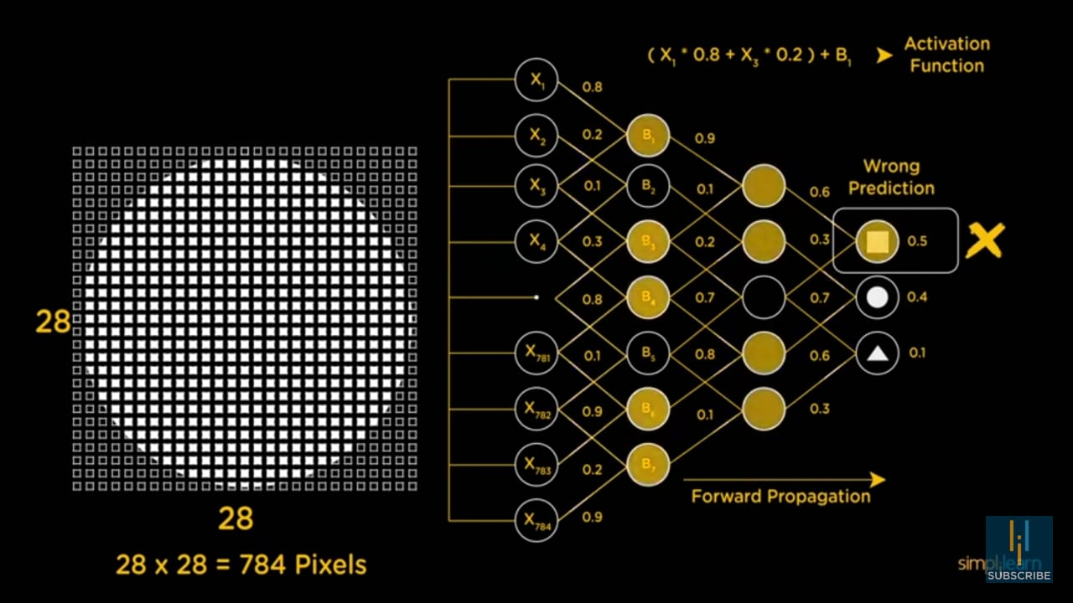
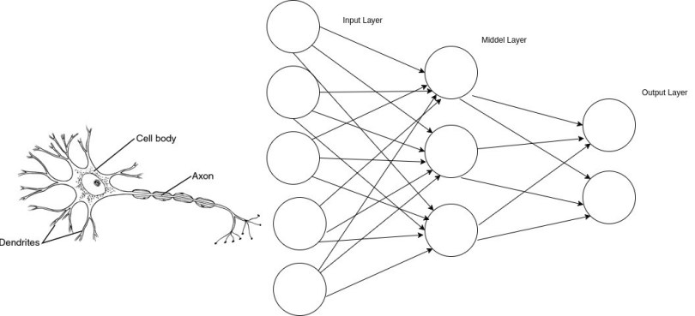
NEURAL NETWORKS
A method of computing, based on the interaction of multiple connected processing elements.
A powerful technique to solve many real world problems.
The ability to learn from experience in order to improve their performance.
Ability to deal with incomplete information.

Slide 10
TYPES OF NEURAL NETWORKS
Neural Network types can be classified based on following attributes:
Connection Type
  Static (feed-forward)
  Dynamic (feedback)
Topology
  Single layer
  Multi layer
  Recurrent
Learning Methods
  Supervised
  Unsupervised
  Reinforcement

Slide 11
NEURAL NETWORKS APPLICATIONS
Pattern recognition
Investment analysis
Control systems & monitoring
Marketing and financial applications

Slide 12
ADVANTAGES
A neural network can perform tasks that a linear program can not.
A neural network learns and does not need to be reprogrammed.
DISADVANTAGES
The neural network needs training to operate.
Requires high processing time for large neural networks.

Slide 13
REFERNCES
Berk, Richard A. (2007). "Regression Analysis: A Constructive Critique". Criminal Justice Review. 32 (3): 301–302. doi:10.1177/0734016807304871.
Warne, Russell T. (2011). "Beyond multiple regression: Using commonality analysis to better understand R2 results". Gifted Child Quarterly. 55 (4): 313–318. doi:10.1177/0016986211422217.
Brillinger, David R. (1977). "The Identification of a Particular Nonlinear Time Series System". Biometrika. 64 (3): 509–515. doi:10.1093/biomet/64.3.509. JSTOR 2345326.
Lange, Kenneth L.; Little, Roderick J. A.; Taylor, Jeremy M. G. (1989). "Robust Statistical Modeling Using the t Distribution" (PDF). Journal of the American Statistical Association. 84 (408): 881–896. doi:10.2307/2290063. JSTOR 2290063.
Russell, Stuart; Norvig, Peter (2003) [1995]. Artificial Intelligence: A Modern Approach(2nd ed.). Prentice Hall. ISBN 978-0137903955.
Hand, D. J.; Yu, K. (2001). "Idiot's Bayes — not so stupid after all?". International Statistical Review. 69 (3): 385–399. doi:10.2307/1403452. ISSN 0306-7734. JSTOR 1403452.
Zhang, Harry. The Optimality of Naive Bayes (PDF). FLAIRS2004 conference.
Caruana, R.; Niculescu-Mizil, A. (2006). An empirical comparison of supervised learning algorithms. Proc. 23rd International Conference on Machine Learning. CiteSeerX 10.1.1.122.5901.

